Slide 1
The lazy and easily distracted report writer
Mike K Smith (Pfizer R&D UK Ltd.)
@MikeKSmith
RStudio::conf(2019)

Slide 2
TL;DR - Disclaimer
I used rmarkdown notebooks / documents to write up an exploratory analysis to share with a drug development team.
Statistician
Clinical Pharmacologist
Clinician
My manager
The analysis presented here is NOT that analysis (for confidentiality) but it has similar attributes.

Slide 3
Your (my) brain is lazy, shallow, and easily distracted.
https://www.slideshare.net/CJAtherton/chris-atherton-at-presentation-camp-london

Slide 4
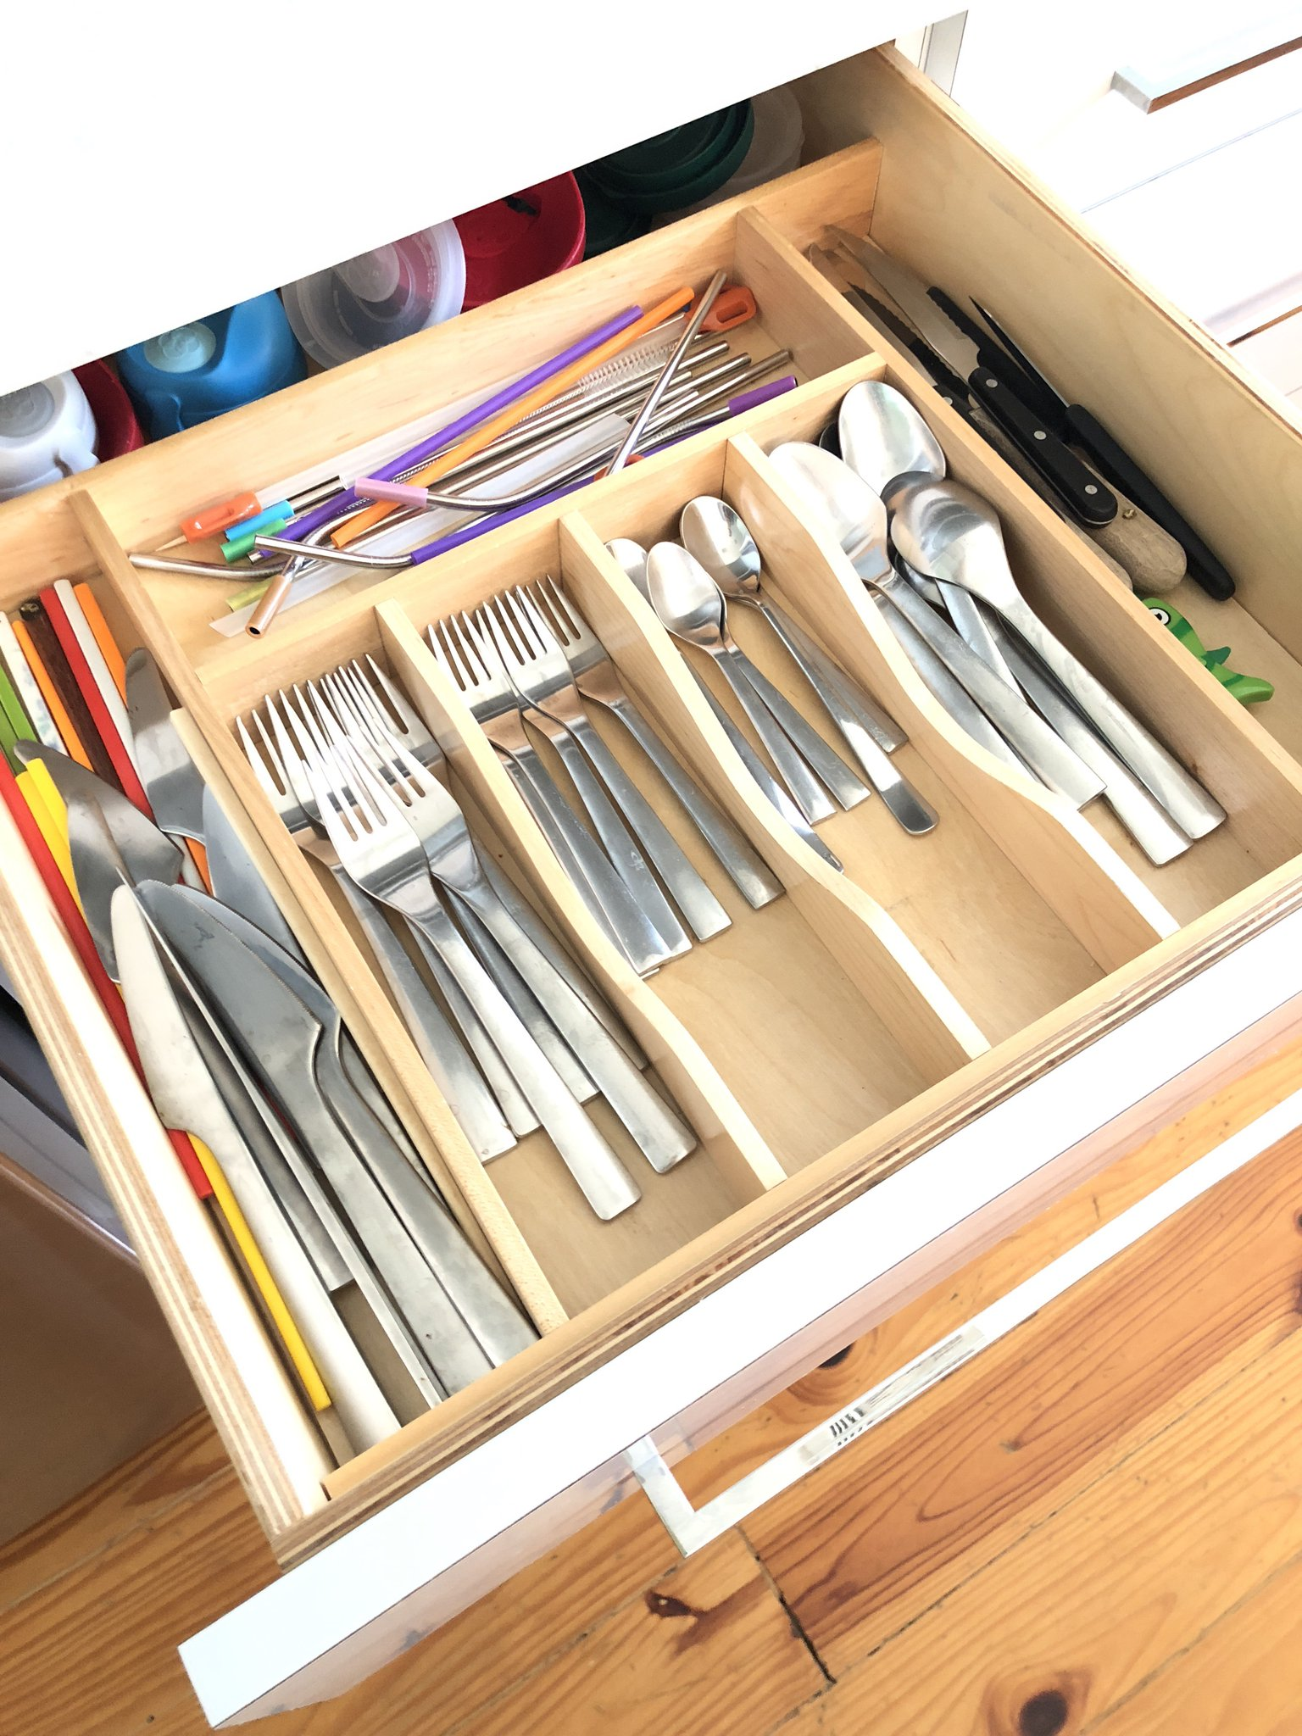
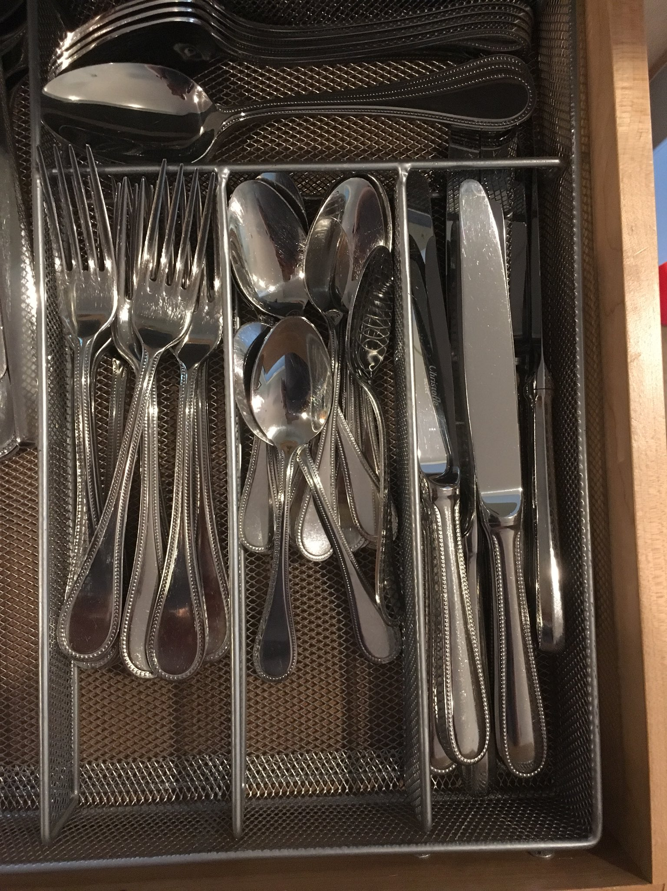
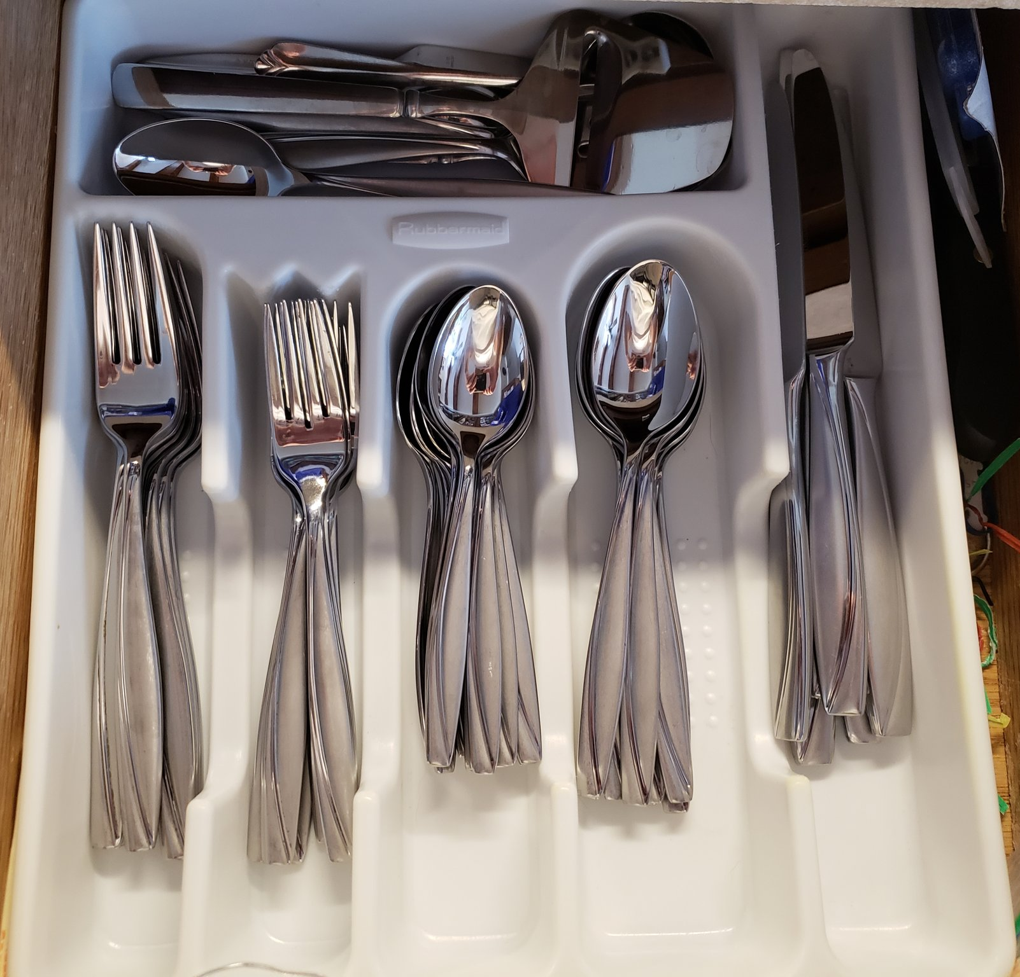
Cutlery drawers &
what they say about YOU
HT: @HadleyWickham, @jimhester_, @dataandme

Slide 5
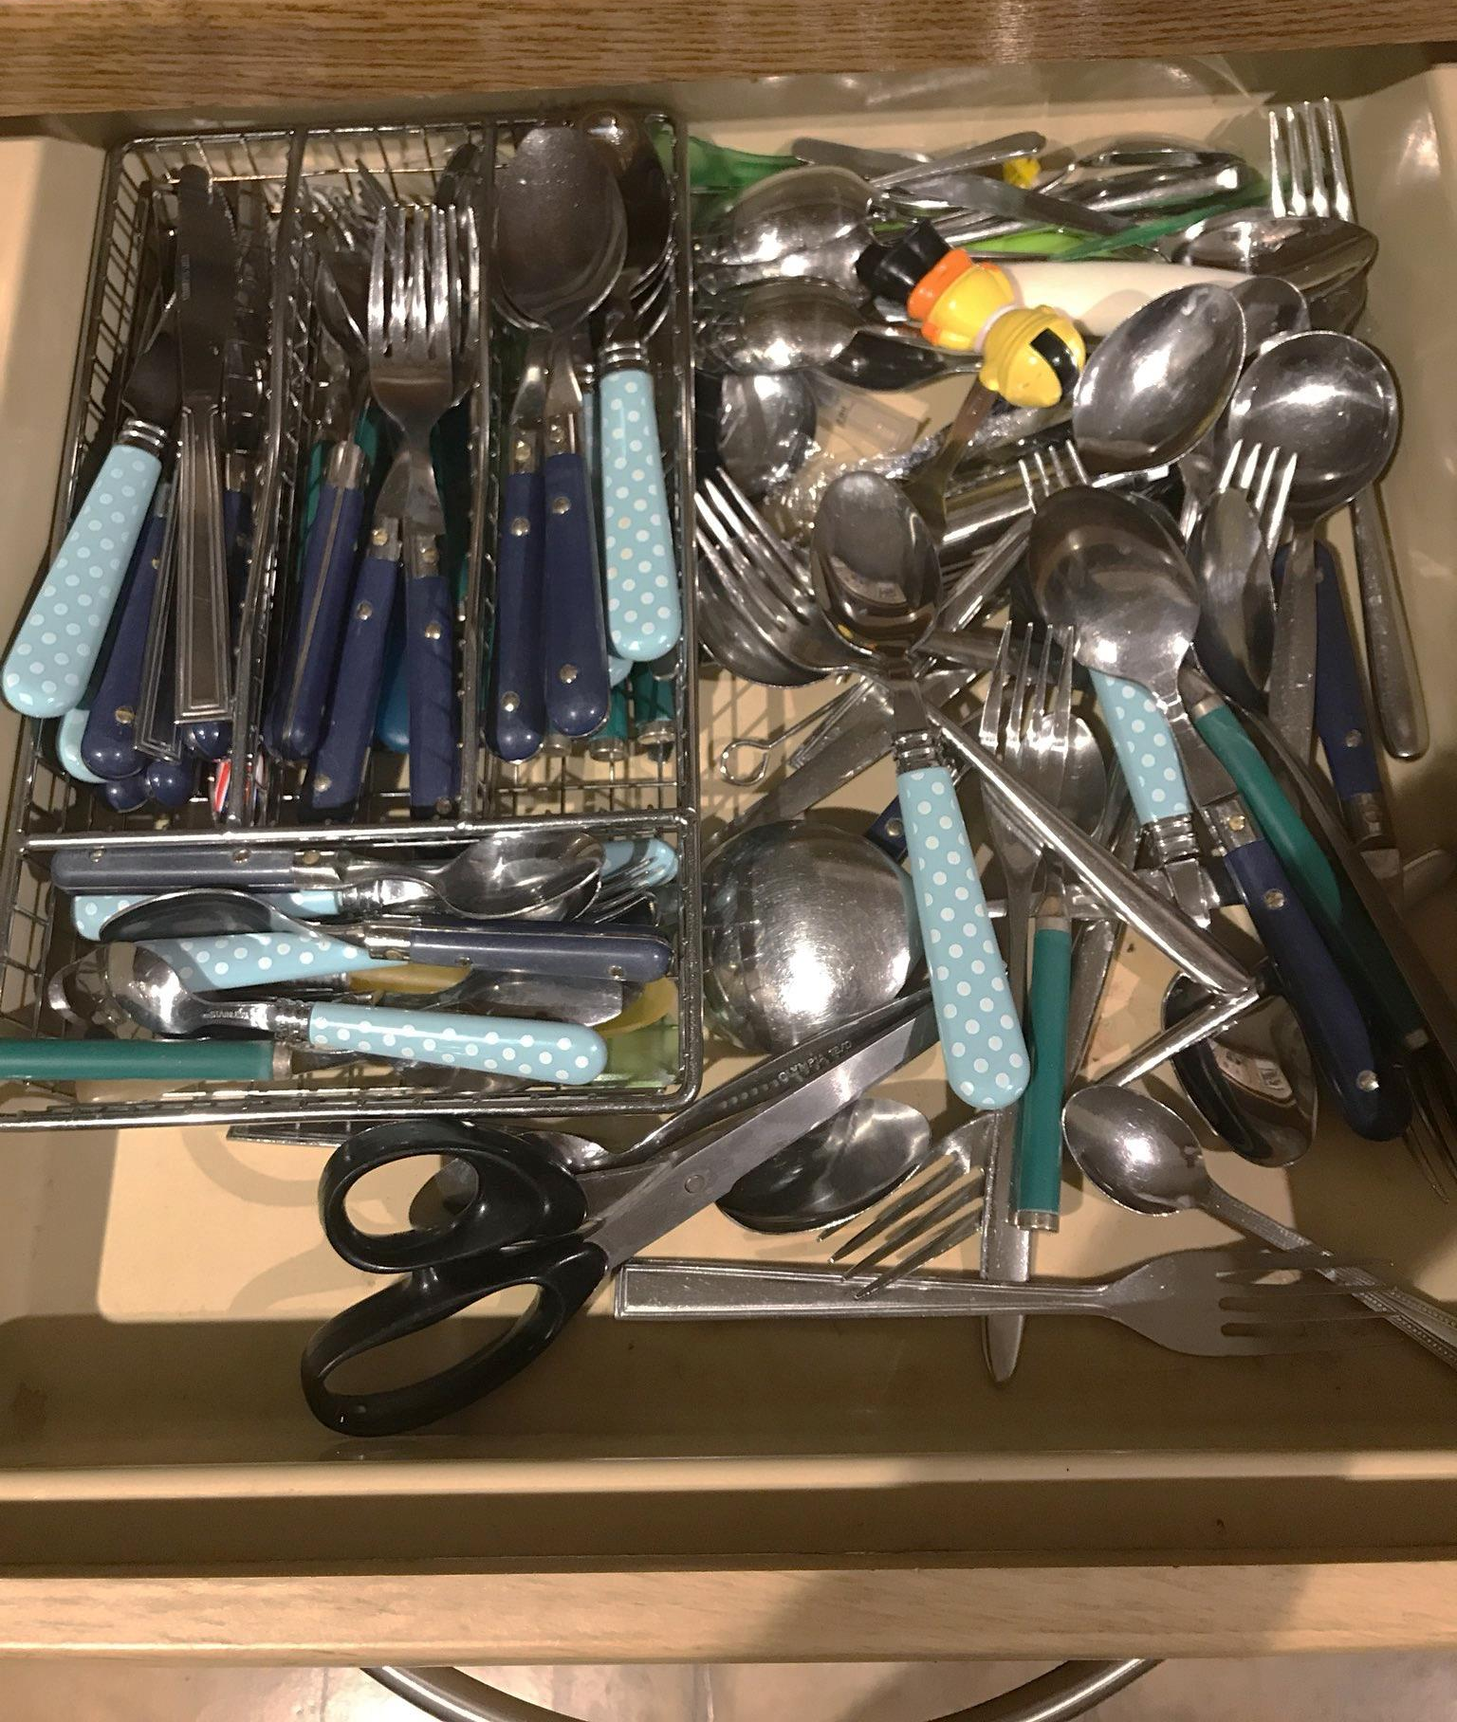
Mine… (sorry / not sorry)

Slide 6
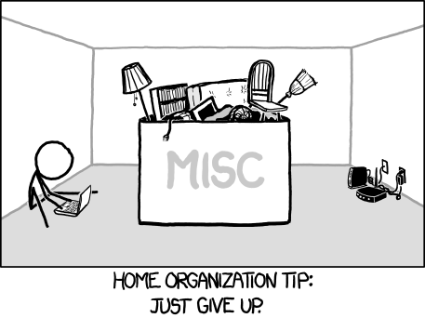
https://xkcd.com/1077/

Slide 7
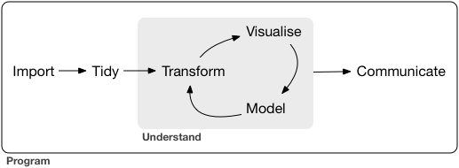
Data analysis - THEORY
https://r4ds.had.co.nz/

Slide 8
Data Analysis – In practice….
(DISCLAIMER: I’m sure the experiences
recounted here are unique to me alone.
See cutlery drawer pictures for proof…)

Slide 9
Go to email with link to data source…
read and respond to 3 other emails…
Download and read data into R…
stop and answer colleague’s question(s)
about the tidyverse…
Wrangle data and plot it…

Slide 10
LUNCH
go to an (unrelated) meeting / teleconference call.

Slide 11
Make better plots.
follow an interesting link that
Mara Averick (@dataandme)
just posted on Twitter
Fit preliminary model to data.

Slide 12
<Next day>
Team find problem with data,
share new version of data.
Change input data and redo analysis.
Check new version against
previous version.

Slide 13
Discuss findings with my boss.
file expenses.
Circulate report.
DONE!!!

Slide 14
< 3 months pass >
Review comments come back…
Wait… Erm… WHAT was I thinking?

Slide 15


To the rescue…
rmarkdown & notebooks

Slide 16
Who is your audience?
Present (distracted) me
Future (3 months later) me
Quantitative colleagues / reviewers
Decision makers (may not be quantitative)

Slide 17
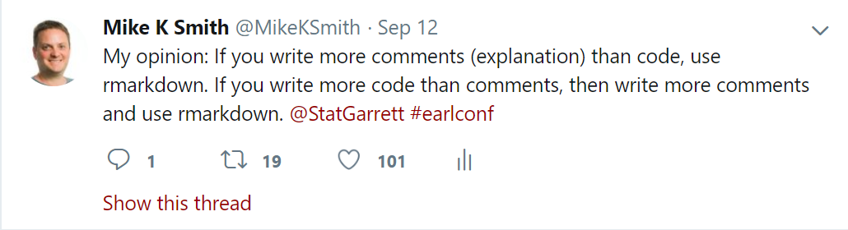
Notebooks / markdown vs scripts (for analysis)
BUT, see also: https://yihui.name/en/2018/09/notebook-war/

Slide 18
Also…
I knew my manager / other reviewers would ask for reports on the THREE different endpoints.

Slide 19
Rule of three
Copy & paste code ≥3 times?
Write and use a function
Perform analysis across ≥ 3 endpoints?
Multiple markdown reports?
NOPE. Parameterised reports.

Slide 20
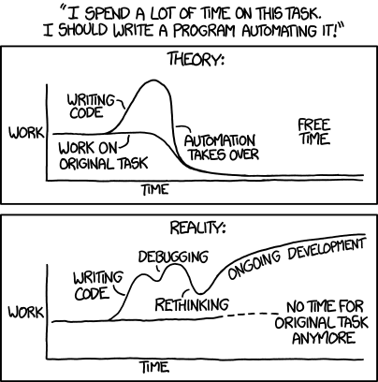
https://xkcd.com/1319/

Slide 21
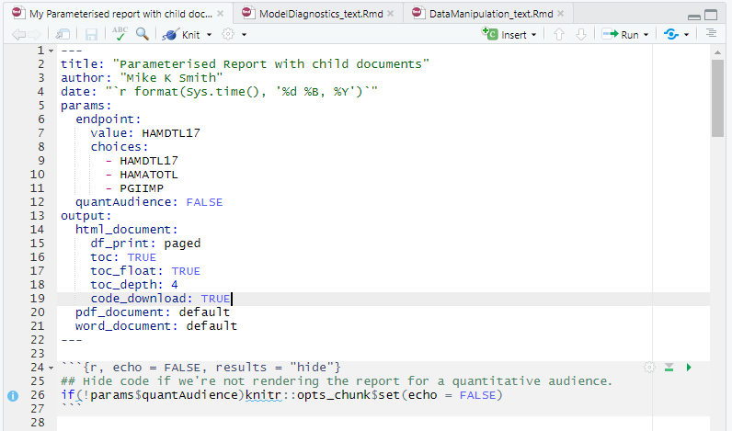
YAML header parameters
Parameters that can be used
in the code / knitr options.
Note that endpoint has only three choices,
and a default value (HAMDTL17)
NB. A bit like Shiny inputs

Slide 22
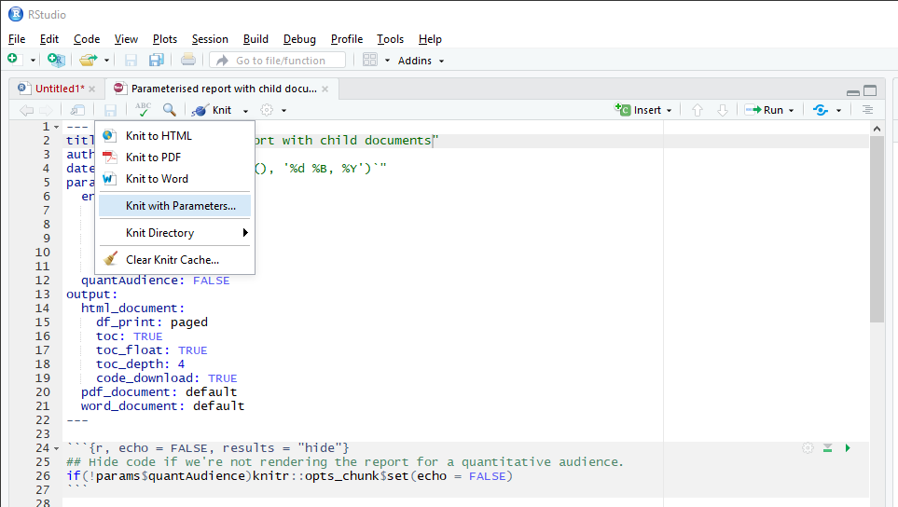
Render with parameters

Slide 23
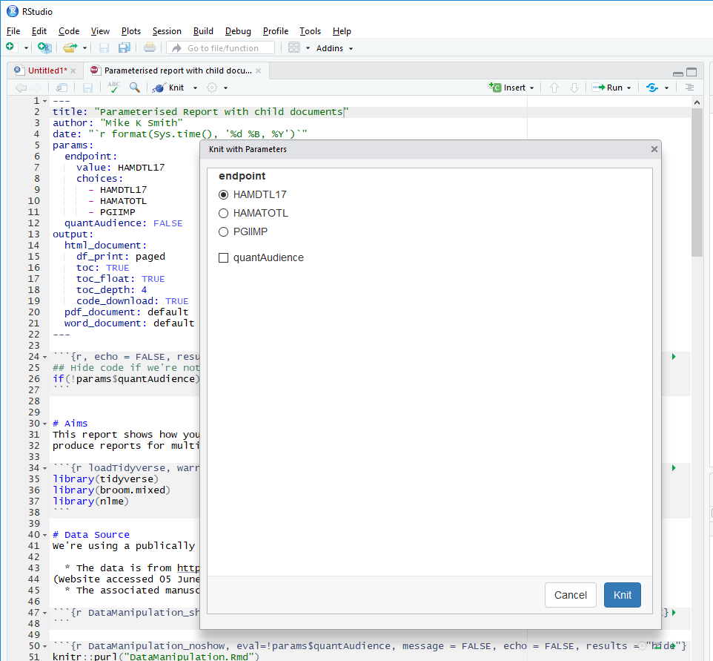
Render with parameters

Slide 24
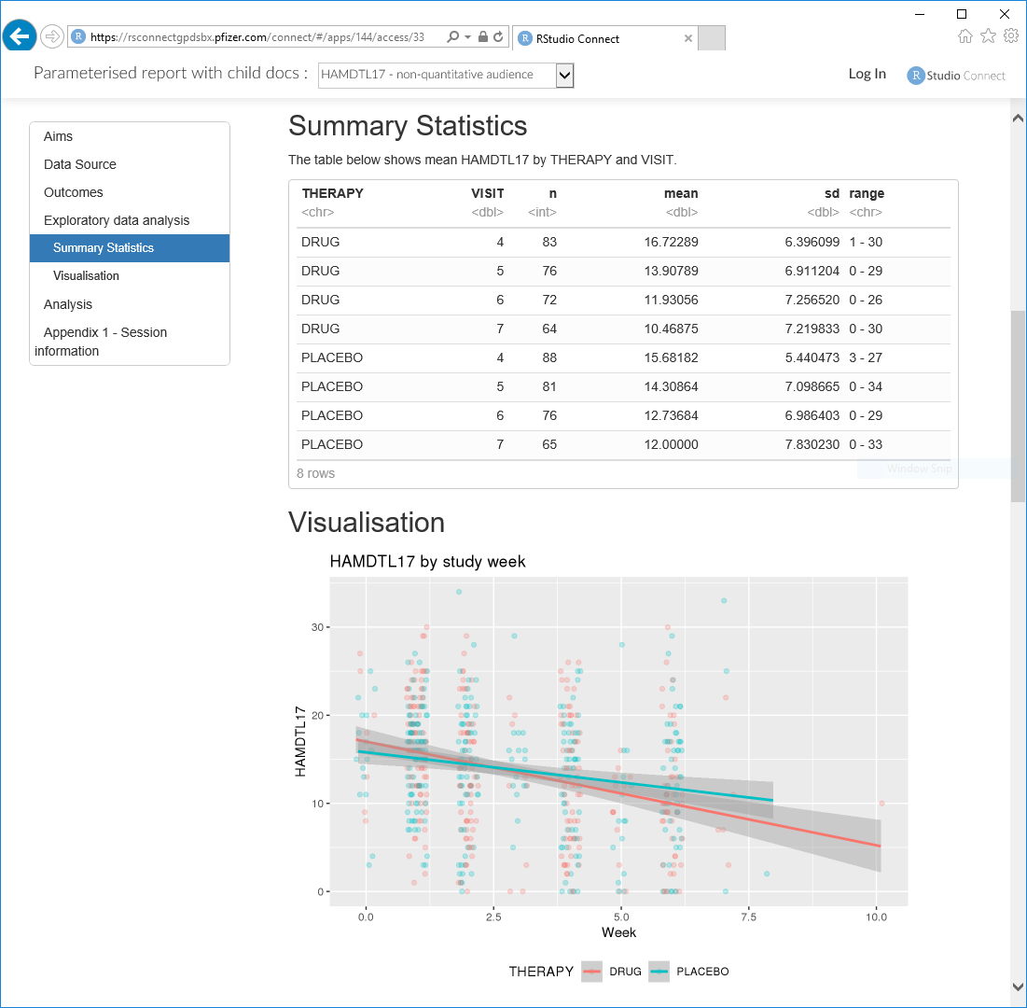
params:
endpoint: HAMDTL17
quantAudience: FALSE
Using params$endpoint
in markdown text, plot code

Slide 25
Parameters that can be used
in the code / knitr options
Knitr options:
Show code in output ONLY IF quantitative audience,

Slide 26
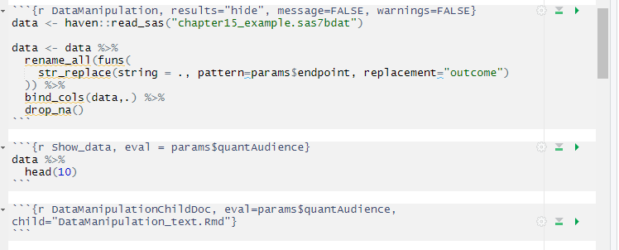
Rename endpoint variable(s) to “outcome” (simplifies later code)
Run this code ONLY IF params$quantAudience = TRUE
Run ONLY IF params$quantAudience = TRUE, to pull in text from child document

Slide 27
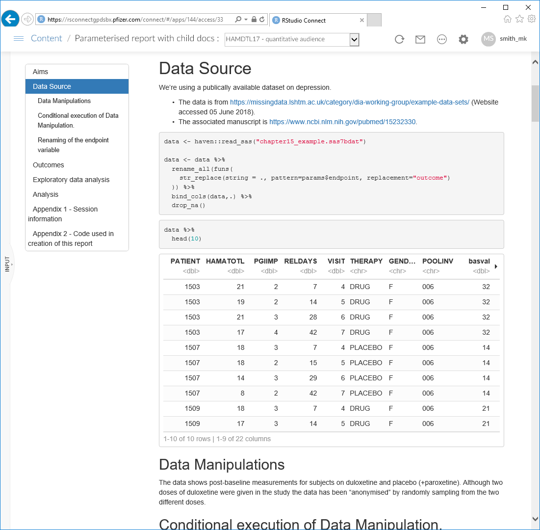
params:
endpoint: HAMDTL17
quantAudience: TRUE
Code shown
Chunk run
Data shown
Child doc text

Slide 28
params:
endpoint: HAMDTL17
quantAudience: TRUE
RStudio Connect allows
you (or visitor to your
page) to specify parameters and render a parameterised report and then to save that report as a named item.
You can then have
pre-rendered reports for
various audiences ready
to go…

Slide 29
More parameterisation
Question: how to show correct analysis for non-continuous endpoint?
Change analysis type in code depending on params$endpoint.
Question: what to do if something goes wrong in the analysis?
Check for errors and handle appropriately using tryCatch(…)
Insert child document text: “EMERGENCY! Something has gone wrong… Contact your data scientist!”

Slide 30
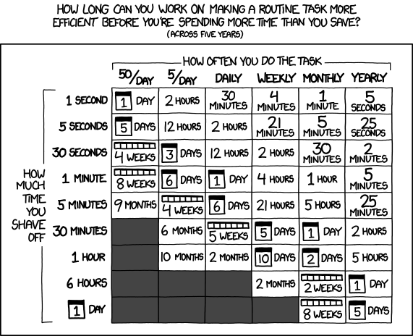
https://xkcd.com/1205/

Slide 31
Feel free to ask me questions, but remember….
https://github.com/MikeKSmith/RStudioConf2019
@MikeKSmith

